Slide 1

AutoConnect
“
"Driving Your Dreams, One Click at a Time"

Slide 2



Project Supervisor: Mr.Ubaid Aftab Chawala
Ishaqullah Siddiqui
Muhib Ahmed
Sarim Latif Khan

Slide 3

PROJECT MOTIVATION
“
- Complex Car Transactions:
- Choosing the right vehicle
- Negotiating prices
- Assessing vehicle history
- Information Overload:
- Abundance of online car information
- Difficulty in making informed decisions
- Trust Concerns:
- Doubts about trustworthiness of buyers and sellers

Slide 4
PROJECT IDEA
"Introducing AutoConnect: Transforming the Way You Buy and Sell Vehicles"
- Simplified Decision-Making:
- Intuitive interface
- Streamlines car transactions
- Simplifies choices for users
- Data Intelligence:
- Aggregates and analyzes data
- Provides accurate information
- Includes vehicle history reports and market trends
- Negotiation Assistance:
- Chatbot support
- Offers insights and suggestions
- Helps with fair and beneficial deals
- Trust & Transparency:
- User-generated reviews and ratings
- Enhances trust
- Real-time messaging for transparent communication
- Personalized Recommendations:
- AI recommendation engine
- Suggests vehicles based on user preferences
- Streamlines the search process

Slide 5
COMPARITVE ANALYSIS
Features | PakWheels | CarFirst | Gaari.pk | AutoConnect
Vehicle Listings | ✓ | ✓ | ✓ | ✓
Selling/Buying Cars | ✓ | ✓ | ✓ | ✓
Vehicle Comparison | ✓ | ✕ | ✓ | ✓
AI Driven Recommendations | ✓ | ✕ | ✕ | ✓
User Reviews | ✓ | ✓ | ✓ | ✓
Customer Support | ✓ | ✓ | ✓ | ✓
Advanced Search Filters | ✓ | ✓ | ✓ | ✓
Live Video Calling | ✕ | ✕ | ✕ | ✓
Smart Negotiation chatbot | ✕ | ✕ | ✕ | ✓

Slide 6
BENIFITS
1. Streamlined Car Transactions:
"Say goodbye to the hassle! Our app simplifies car buying and selling, making it as easy as a few clicks."
2. Negotiation Assistance:
"Negotiate like a pro! Our chatbot helps you get the best deal, putting you in the driver's seat."
3. Real-Time Video Calls:
"See it, believe it! Conduct video calls with the seller, buyer, and even a mechanic for complete transparency."
4. Tailored Recommendations:
"Find your dream ride! Our AI learns your preferences and recommends cars that match your style."
5. Extensive Search and Filters:
"Your perfect match is waiting! Use powerful search and filtering options to find the ideal vehicle."

Slide 7
6. User Reviews and Ratings:
"Trust the community! Read user reviews and ratings to make informed decisions."
7. Instant Messaging and Notifications:
"Stay connected! Our real-time messaging and notifications keep you updated on your car journey."
8. Outstanding Customer Support:
- "We've got your back! Enjoy excellent customer support with our live chat and assistance tools."
9. Revolutionize Negotiations:
- "Empower yourself! We're changing the game with AI-powered negotiations."
10. Modern, Intuitive UI:
- "Beauty and brains! Our app combines stunning design with effortless usability."

Slide 8

KEY FEATURES
“
1. Smart Negotiation Bot: Say goodbye to haggling. Our bot ensures fair deals.
2. Live Video Calling: Expert-guided vehicle inspections in real-time.
3. Comprehensive Listings: A wide variety of vehicles for every preference.
4. Personalized User Accounts: Tailor your journey.
5. Diverse Portals: Connecting users, mechanics, and enthusiasts.
6. Effortless Vehicle Comparison: Make informed decisions effortlessly.
7. Advanced Search and Filters: Find the exact vehicle you desire.
8. Empowering User Reviews: Contribute to an informed community.
9. Real-time Communication: Swift and effective interactions.
10. Insightful Vehicle History: Access to comprehensive and verified vehicle history.
11. Expert Customer Support: Instant resolution for a smooth experience.
12. AI-Driven Recommendations: Your personalized vehicle suggestions.

Slide 9
TECH STACK
Front End
Back End
Chat bot
-React
-MUI
-React Router
-.NET
-Entity Framework
-Postgresql (DB)
-Node JS
-Dialogue Flow
-Dialogue Flow by Google
-Back-End Server
-Node JS for Web hooks

Slide 10
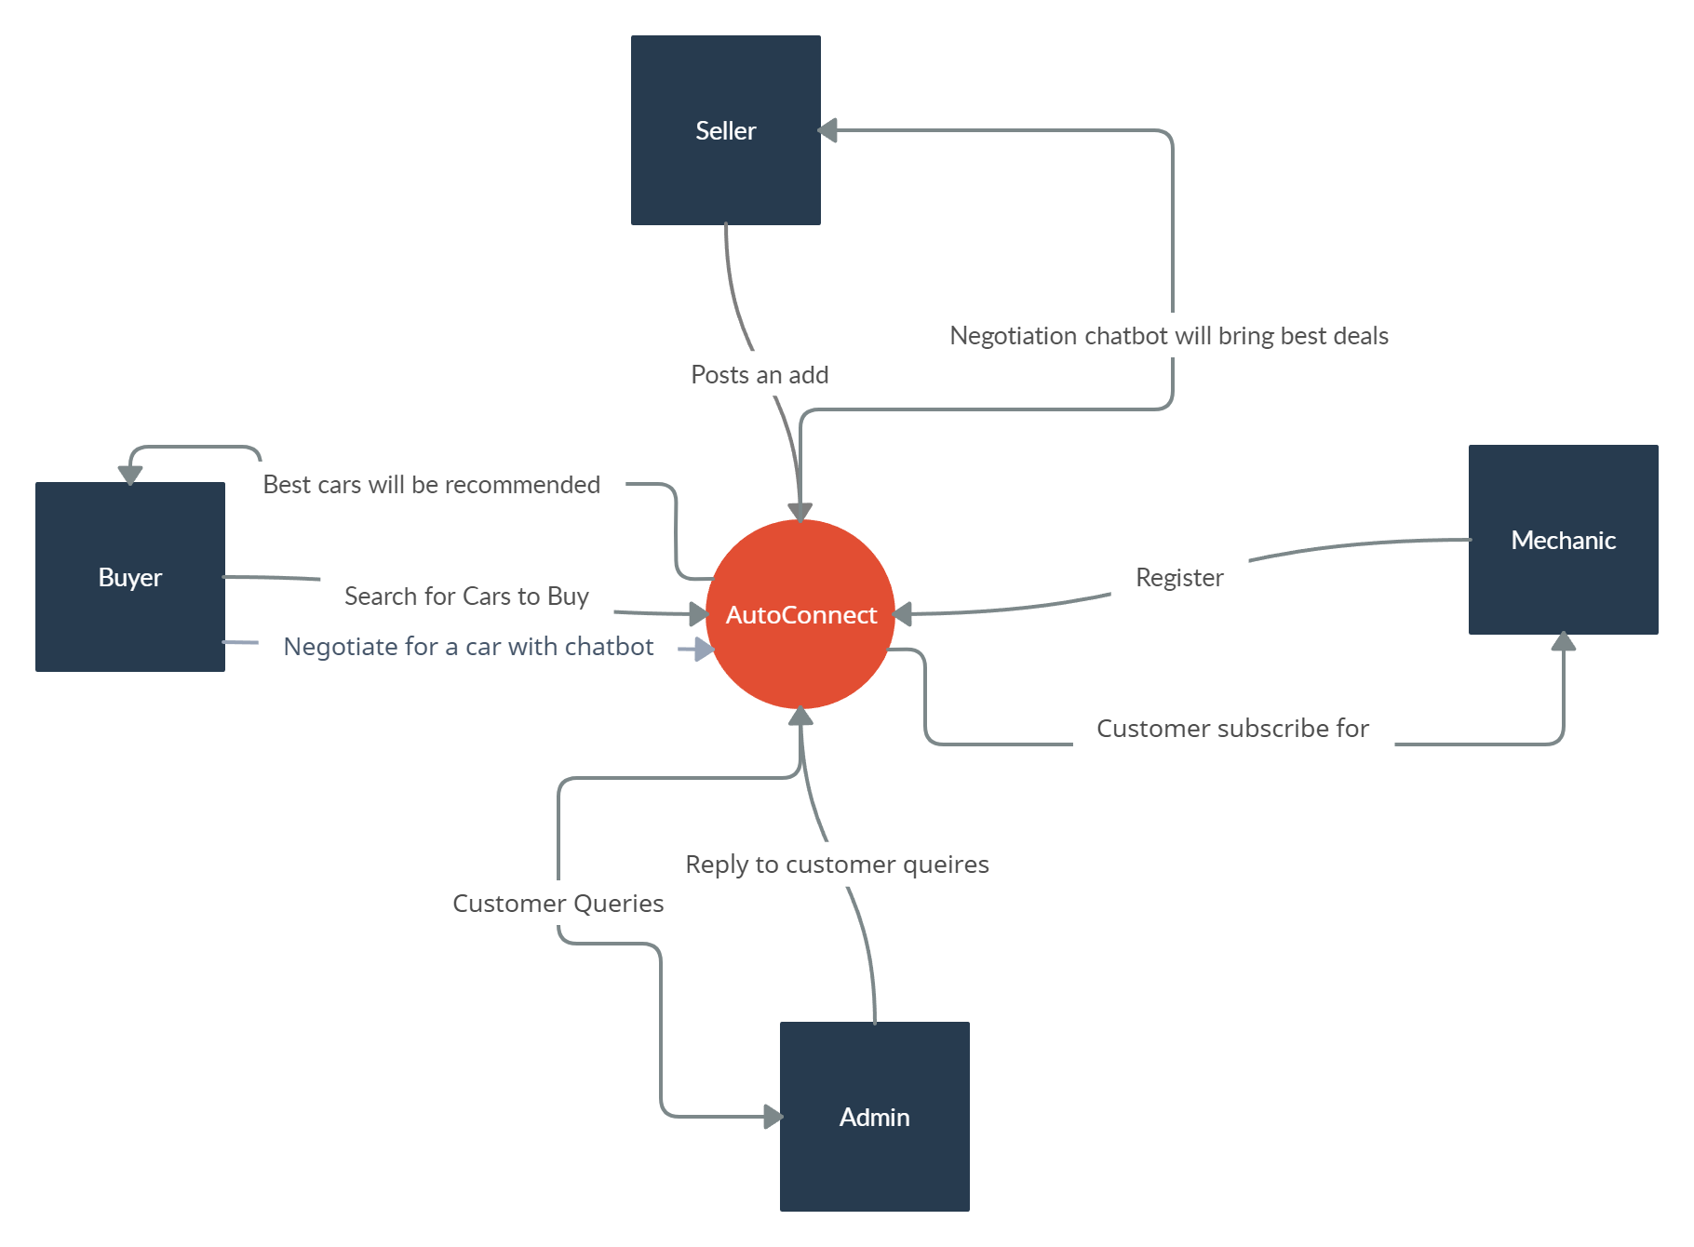
SYSTEM DIAGRAM

Slide 11
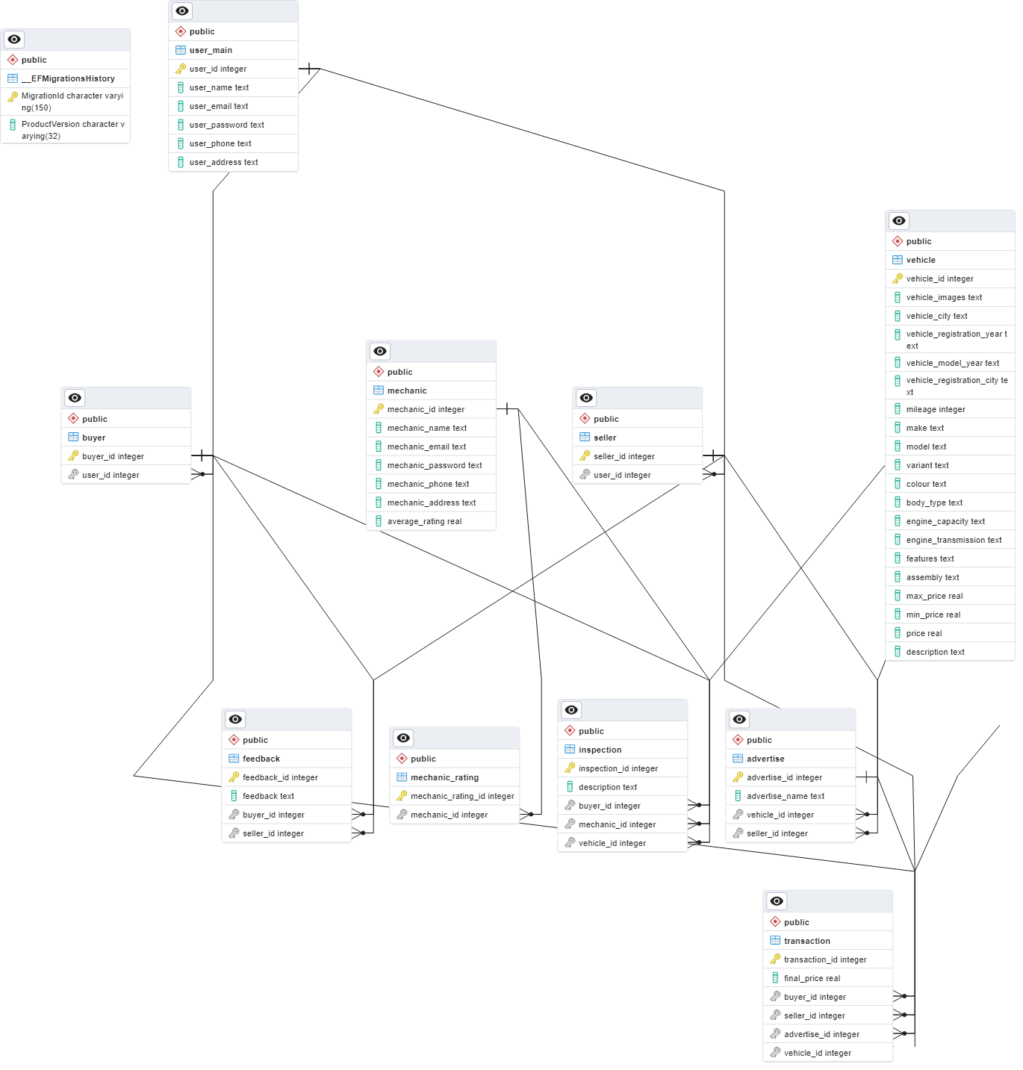
ERD

Slide 12
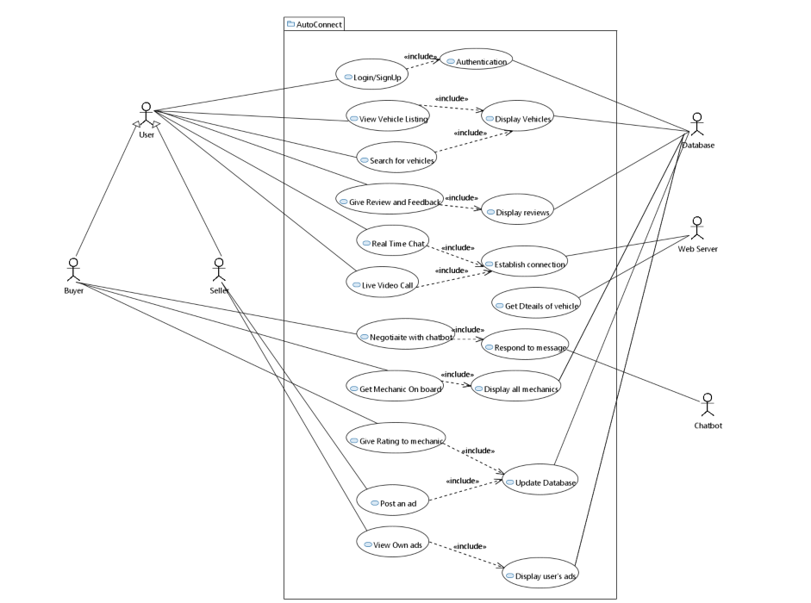
Use Case Diagram (User)

Slide 13
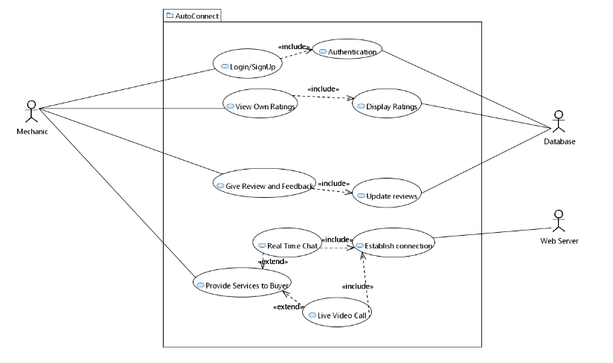
Use Case Diagram (Mechanic)

Slide 14
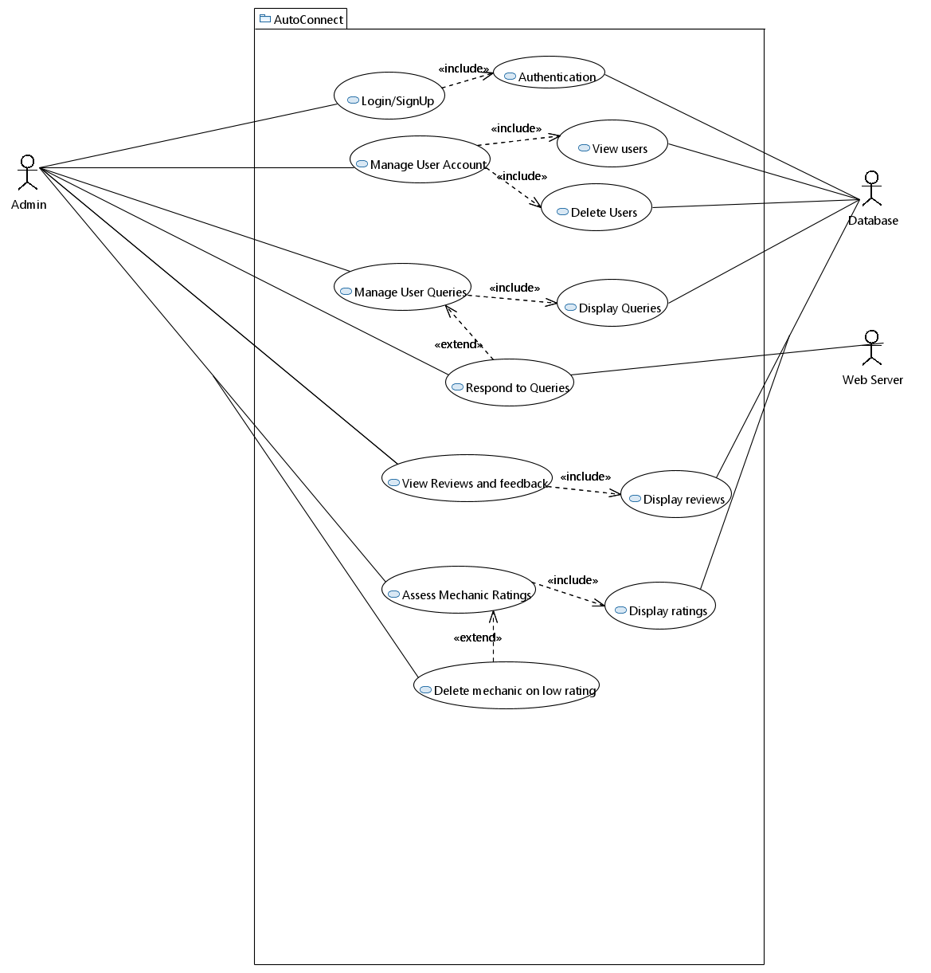
Use Case Diagram (Admin)

Slide 15
FYP-1 Progress
-UI Implementation.
-User Authentication.
-Vehicle Listing.
-Buyer/Seller CRUD operations.
-DB Design.
-Backend Implementation.
-API Development.
-Negotiation Chatbot Implementation.

Slide 16
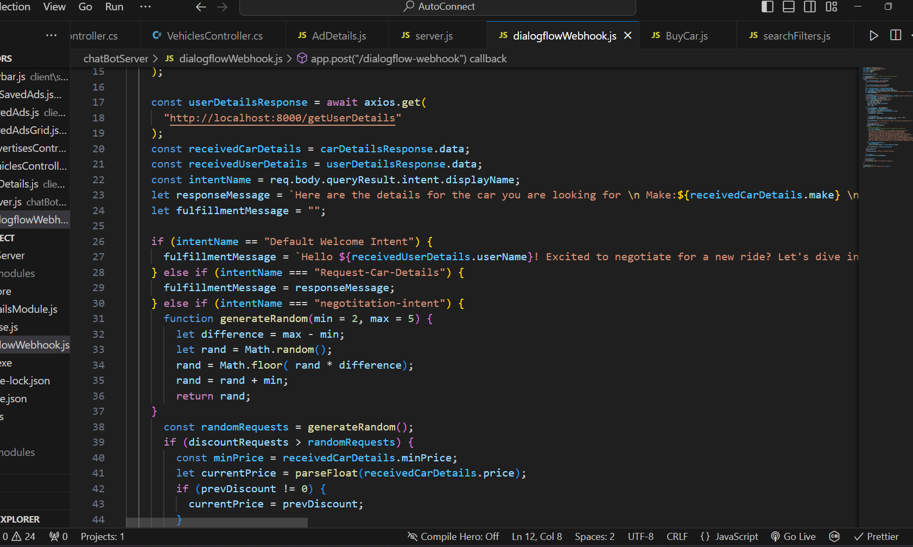
Dialogflow Webhook

Slide 17
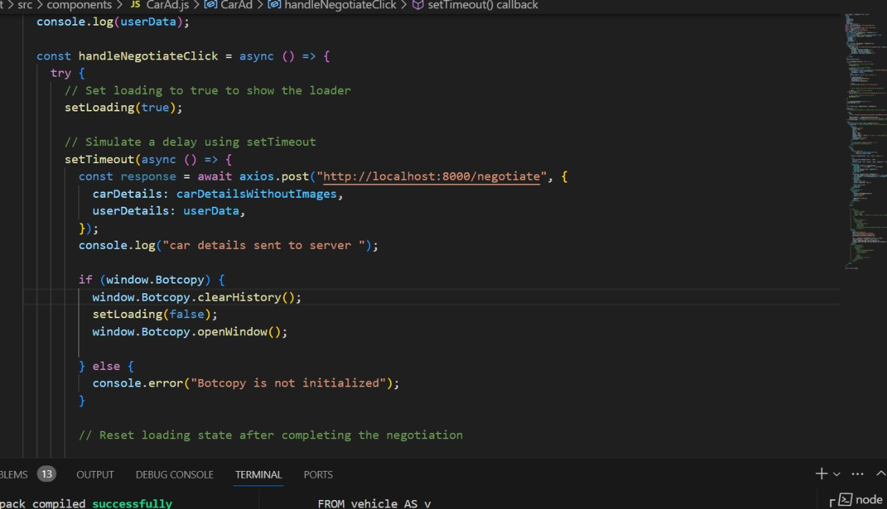
API Calls At Client Side

Slide 18
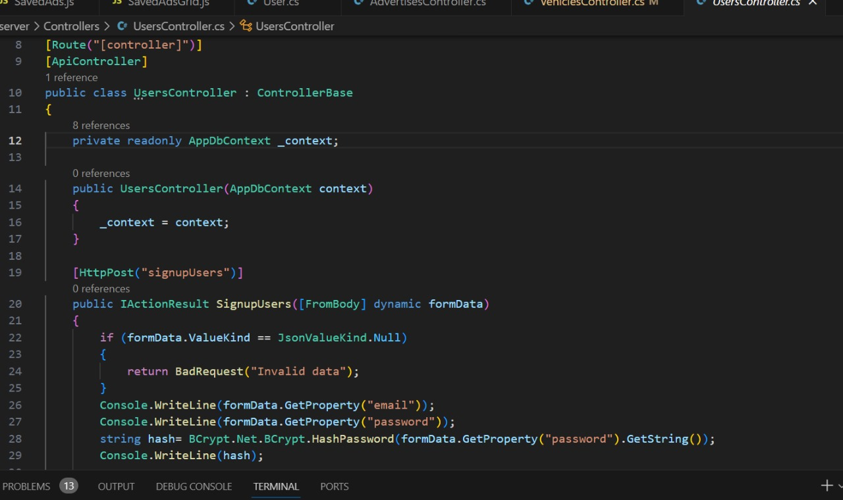
Glance At Controller API

Slide 19
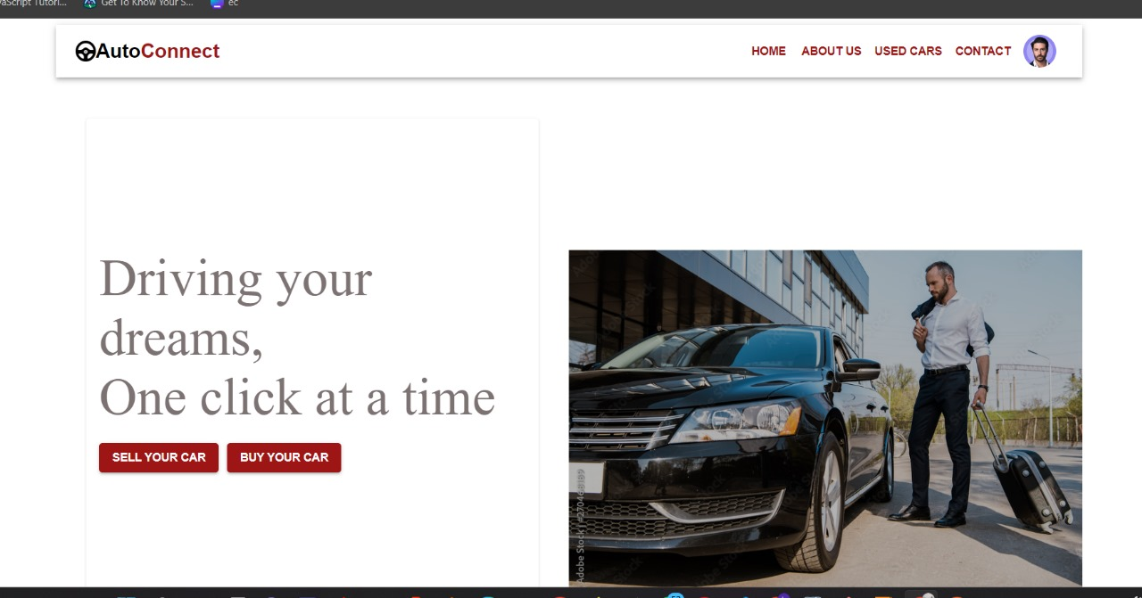
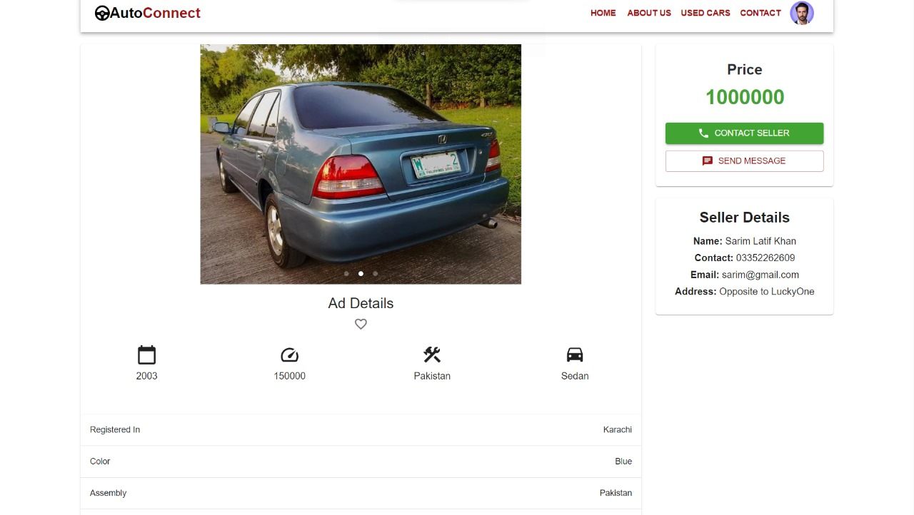
Interface of Web App

Slide 20
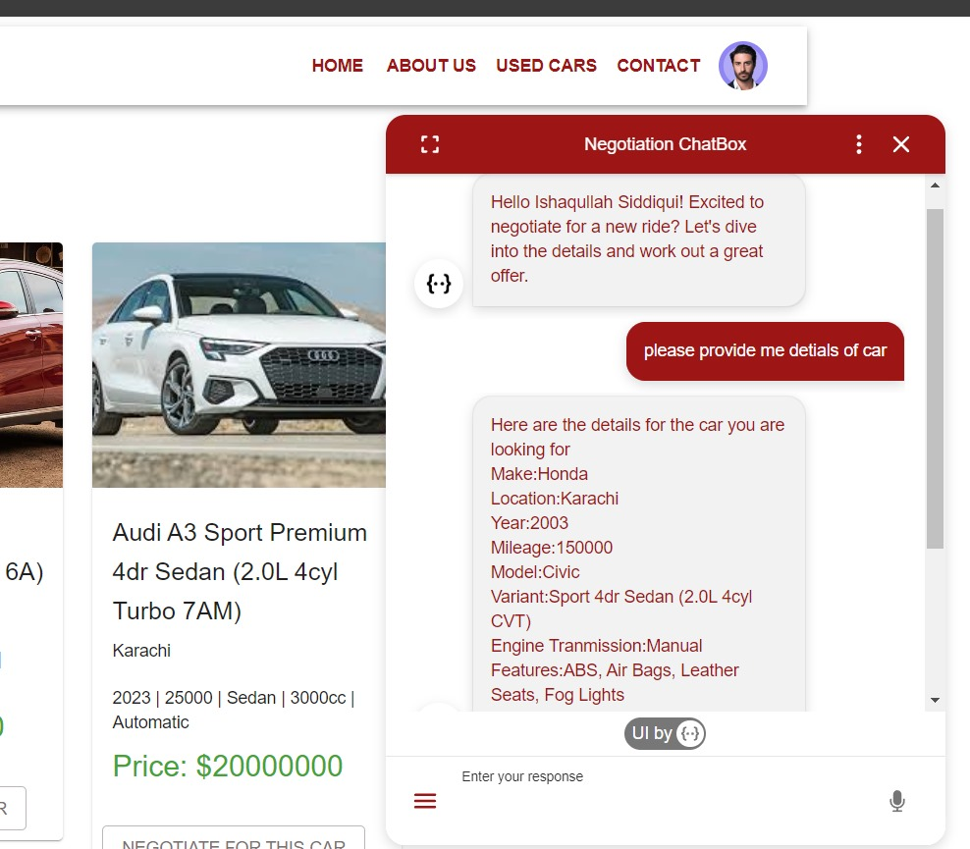
Negotiation Chatbox

Slide 21
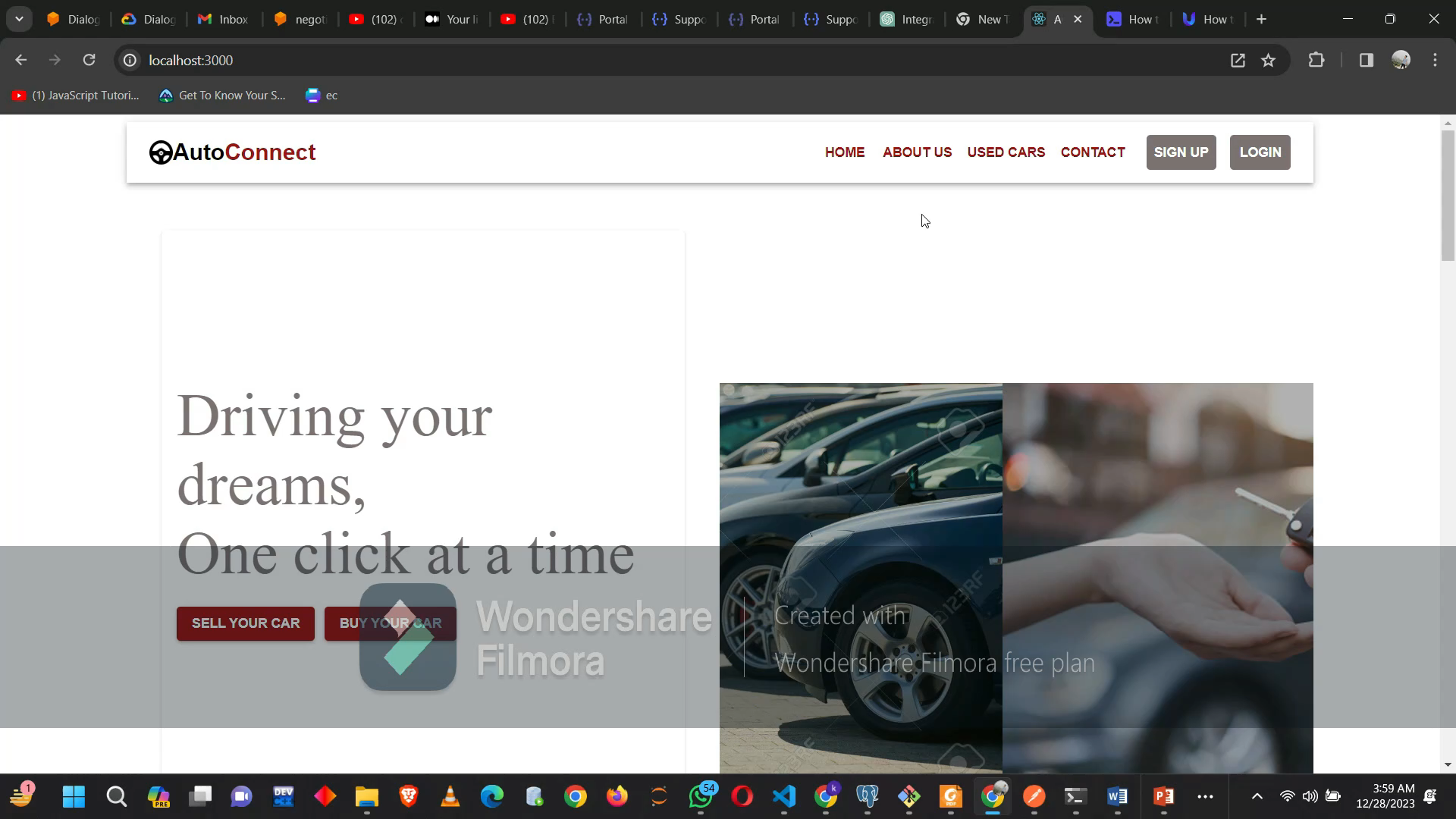
Web App Simulation

Slide 22
TIMELINE
ELAPSED TIME IN MONTHS | MILESTONES
FYP-2
Month-1 January | Search and Filters Mechanic Portal Admin Portal
Month-2 February | Vehicle Comparison Module Customer Support Module User Review Module
Month-3 March | AI Driven Video Calling Feature Realtime Chatting
Month-4 April | Integration and Testing User Manual Final Report

Slide 23
THANKS!

